Slide 1



MPIG Seminar
Clustering
田 琳
Machine Perception and Interaction Group (MPIG)
www.mpig.com.cn
tl@mpig.com.cn
公众号:
mpig_robot

Slide 2


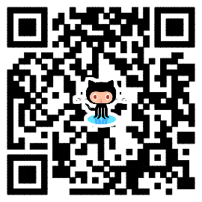
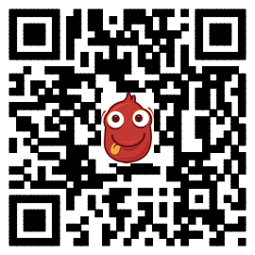
The course notes are partly based on the Machine learning course presented by Andrew Ng at Stanford University and the original can be found at https://www.coursera.org/course/ml b
e.
All materials without annotations or marks are copyrighted by their copyright owner.
All the codes and modified slides are available at Github & OSChina
The project homepage:
https://github.com/sunzuolei/ml
https://git.oschina.net/samuel/ml
The Git repository:
https://github.com/sunzuolei/ml.git
https://git.oschina.net/samuel/ml.git

Slide 3

QQ：704826695
GitHub： https://github.com/tl94ml

Slide 4
Regression
Supervised learning
Classification
. . .
Machine learning
Clustering
Unsupervised learning
. . . . . . .

Slide 5
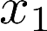
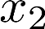
Supervised learning
Training set:

Slide 6
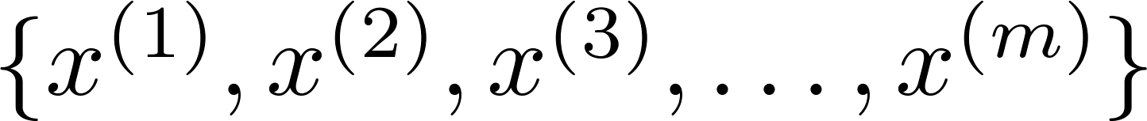
Unsupervised learning
Training set:

Slide 7
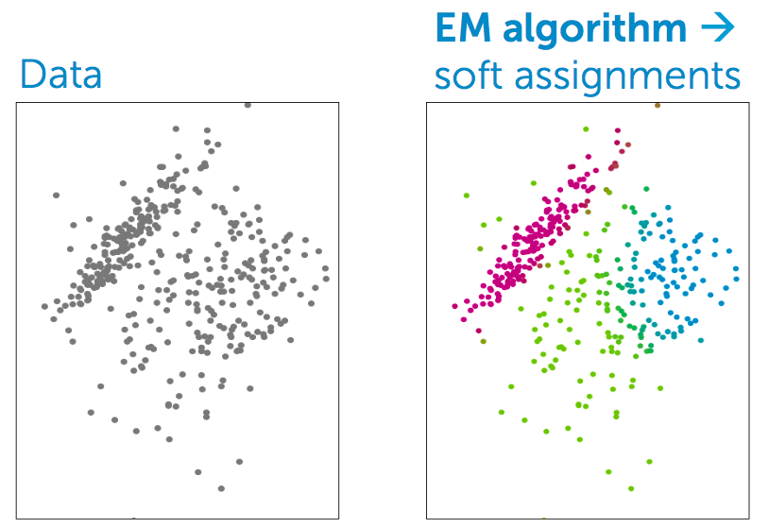
Clustering
K-means —— hard assignment
Unsupervised learning-clustering
Mixture model —— soft assignment —— Expectation Maximization

Slide 8
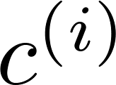

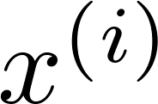
K-means algorithm
Training set:
= index of cluster (1,2,…, ) to which example is currently assigned

Slide 9
K-means algorithm
Initialization
2. cluster assignment
3. move centroid
4. iterative computation 2-3

Slide 10
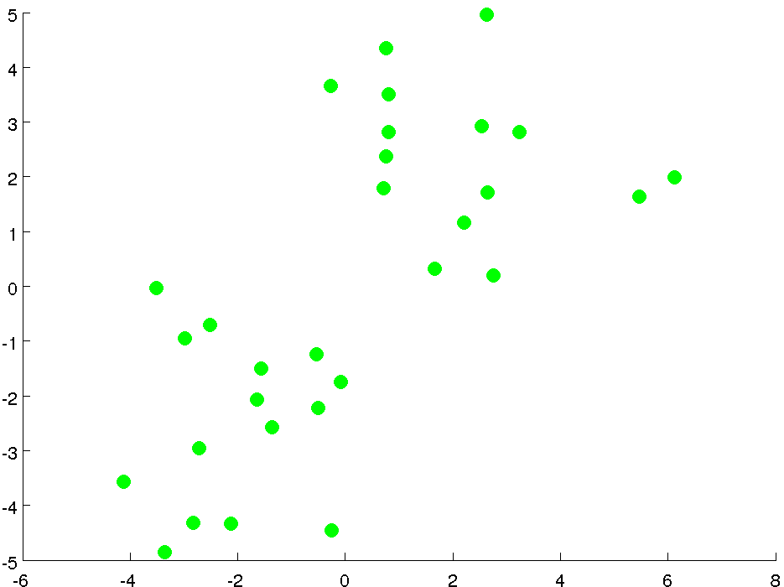

Slide 11
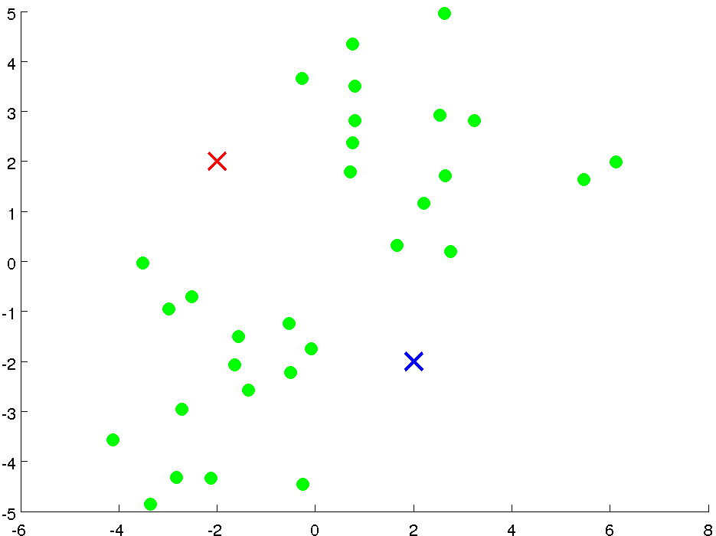

Slide 12
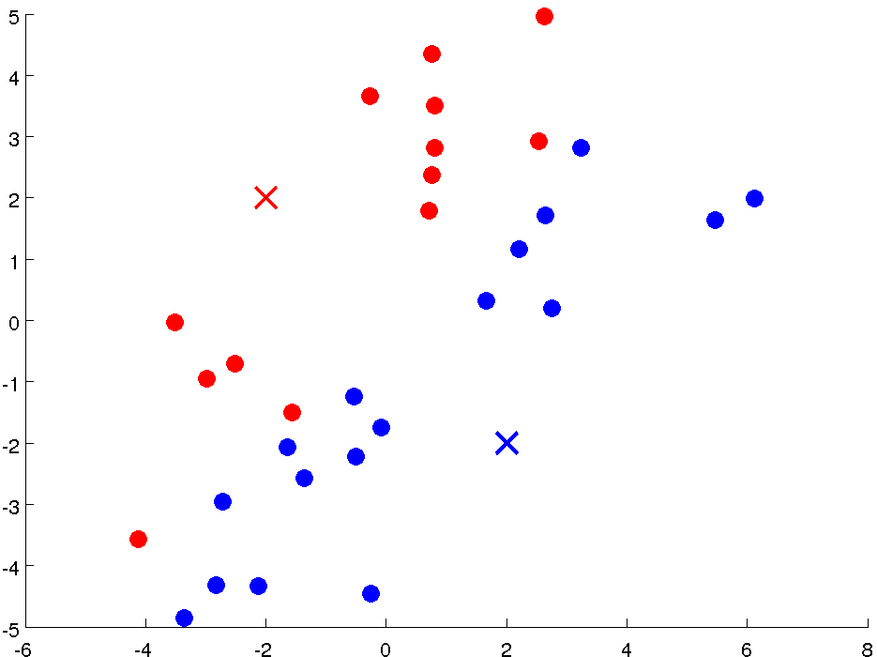

Slide 13
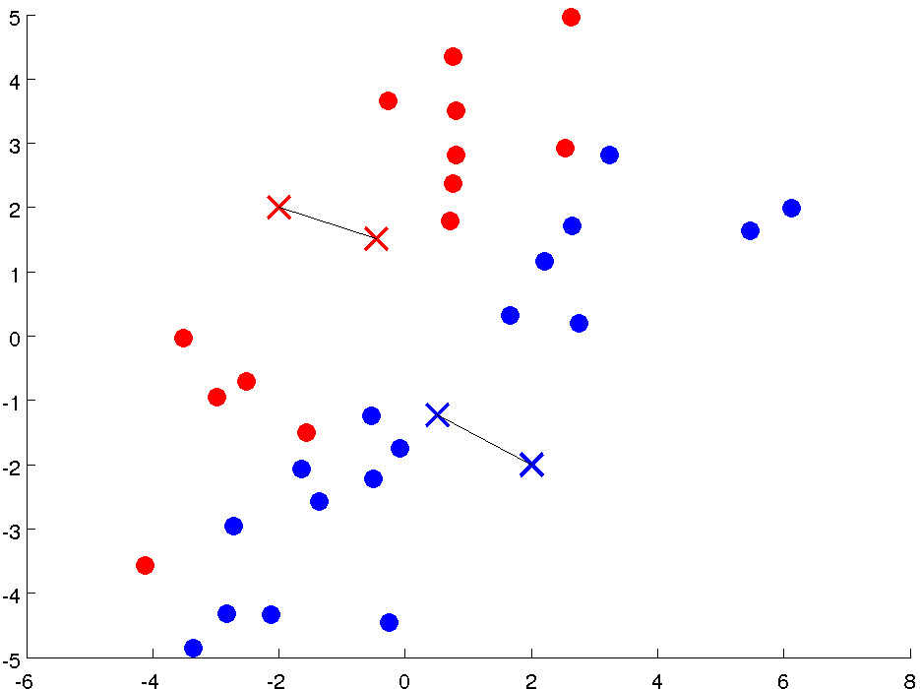


Slide 14
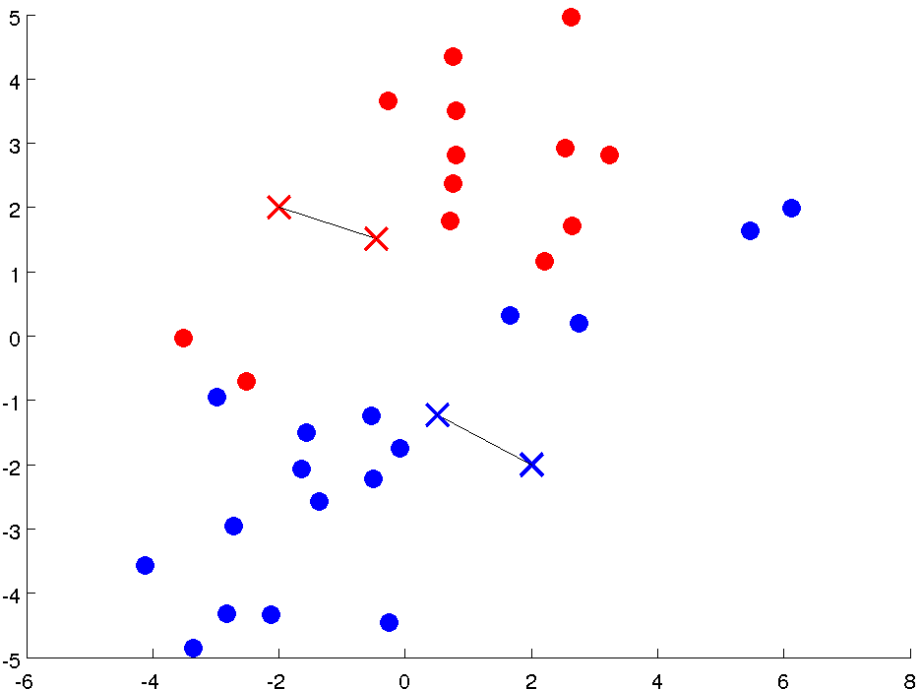

Slide 15
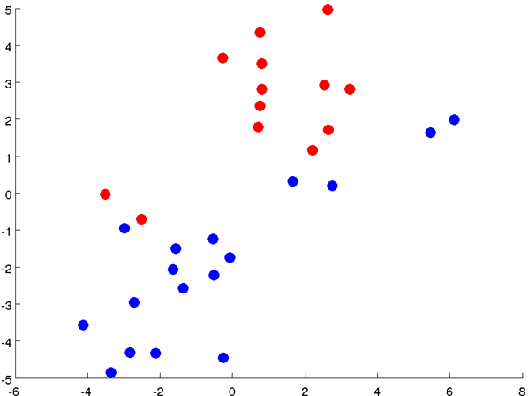

Slide 16
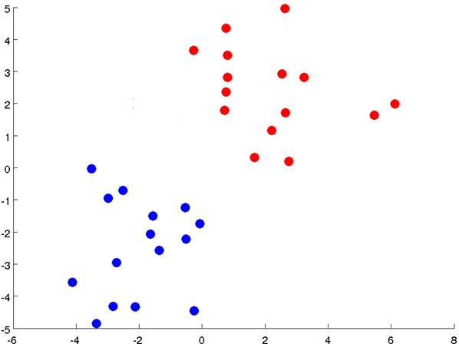

Slide 17
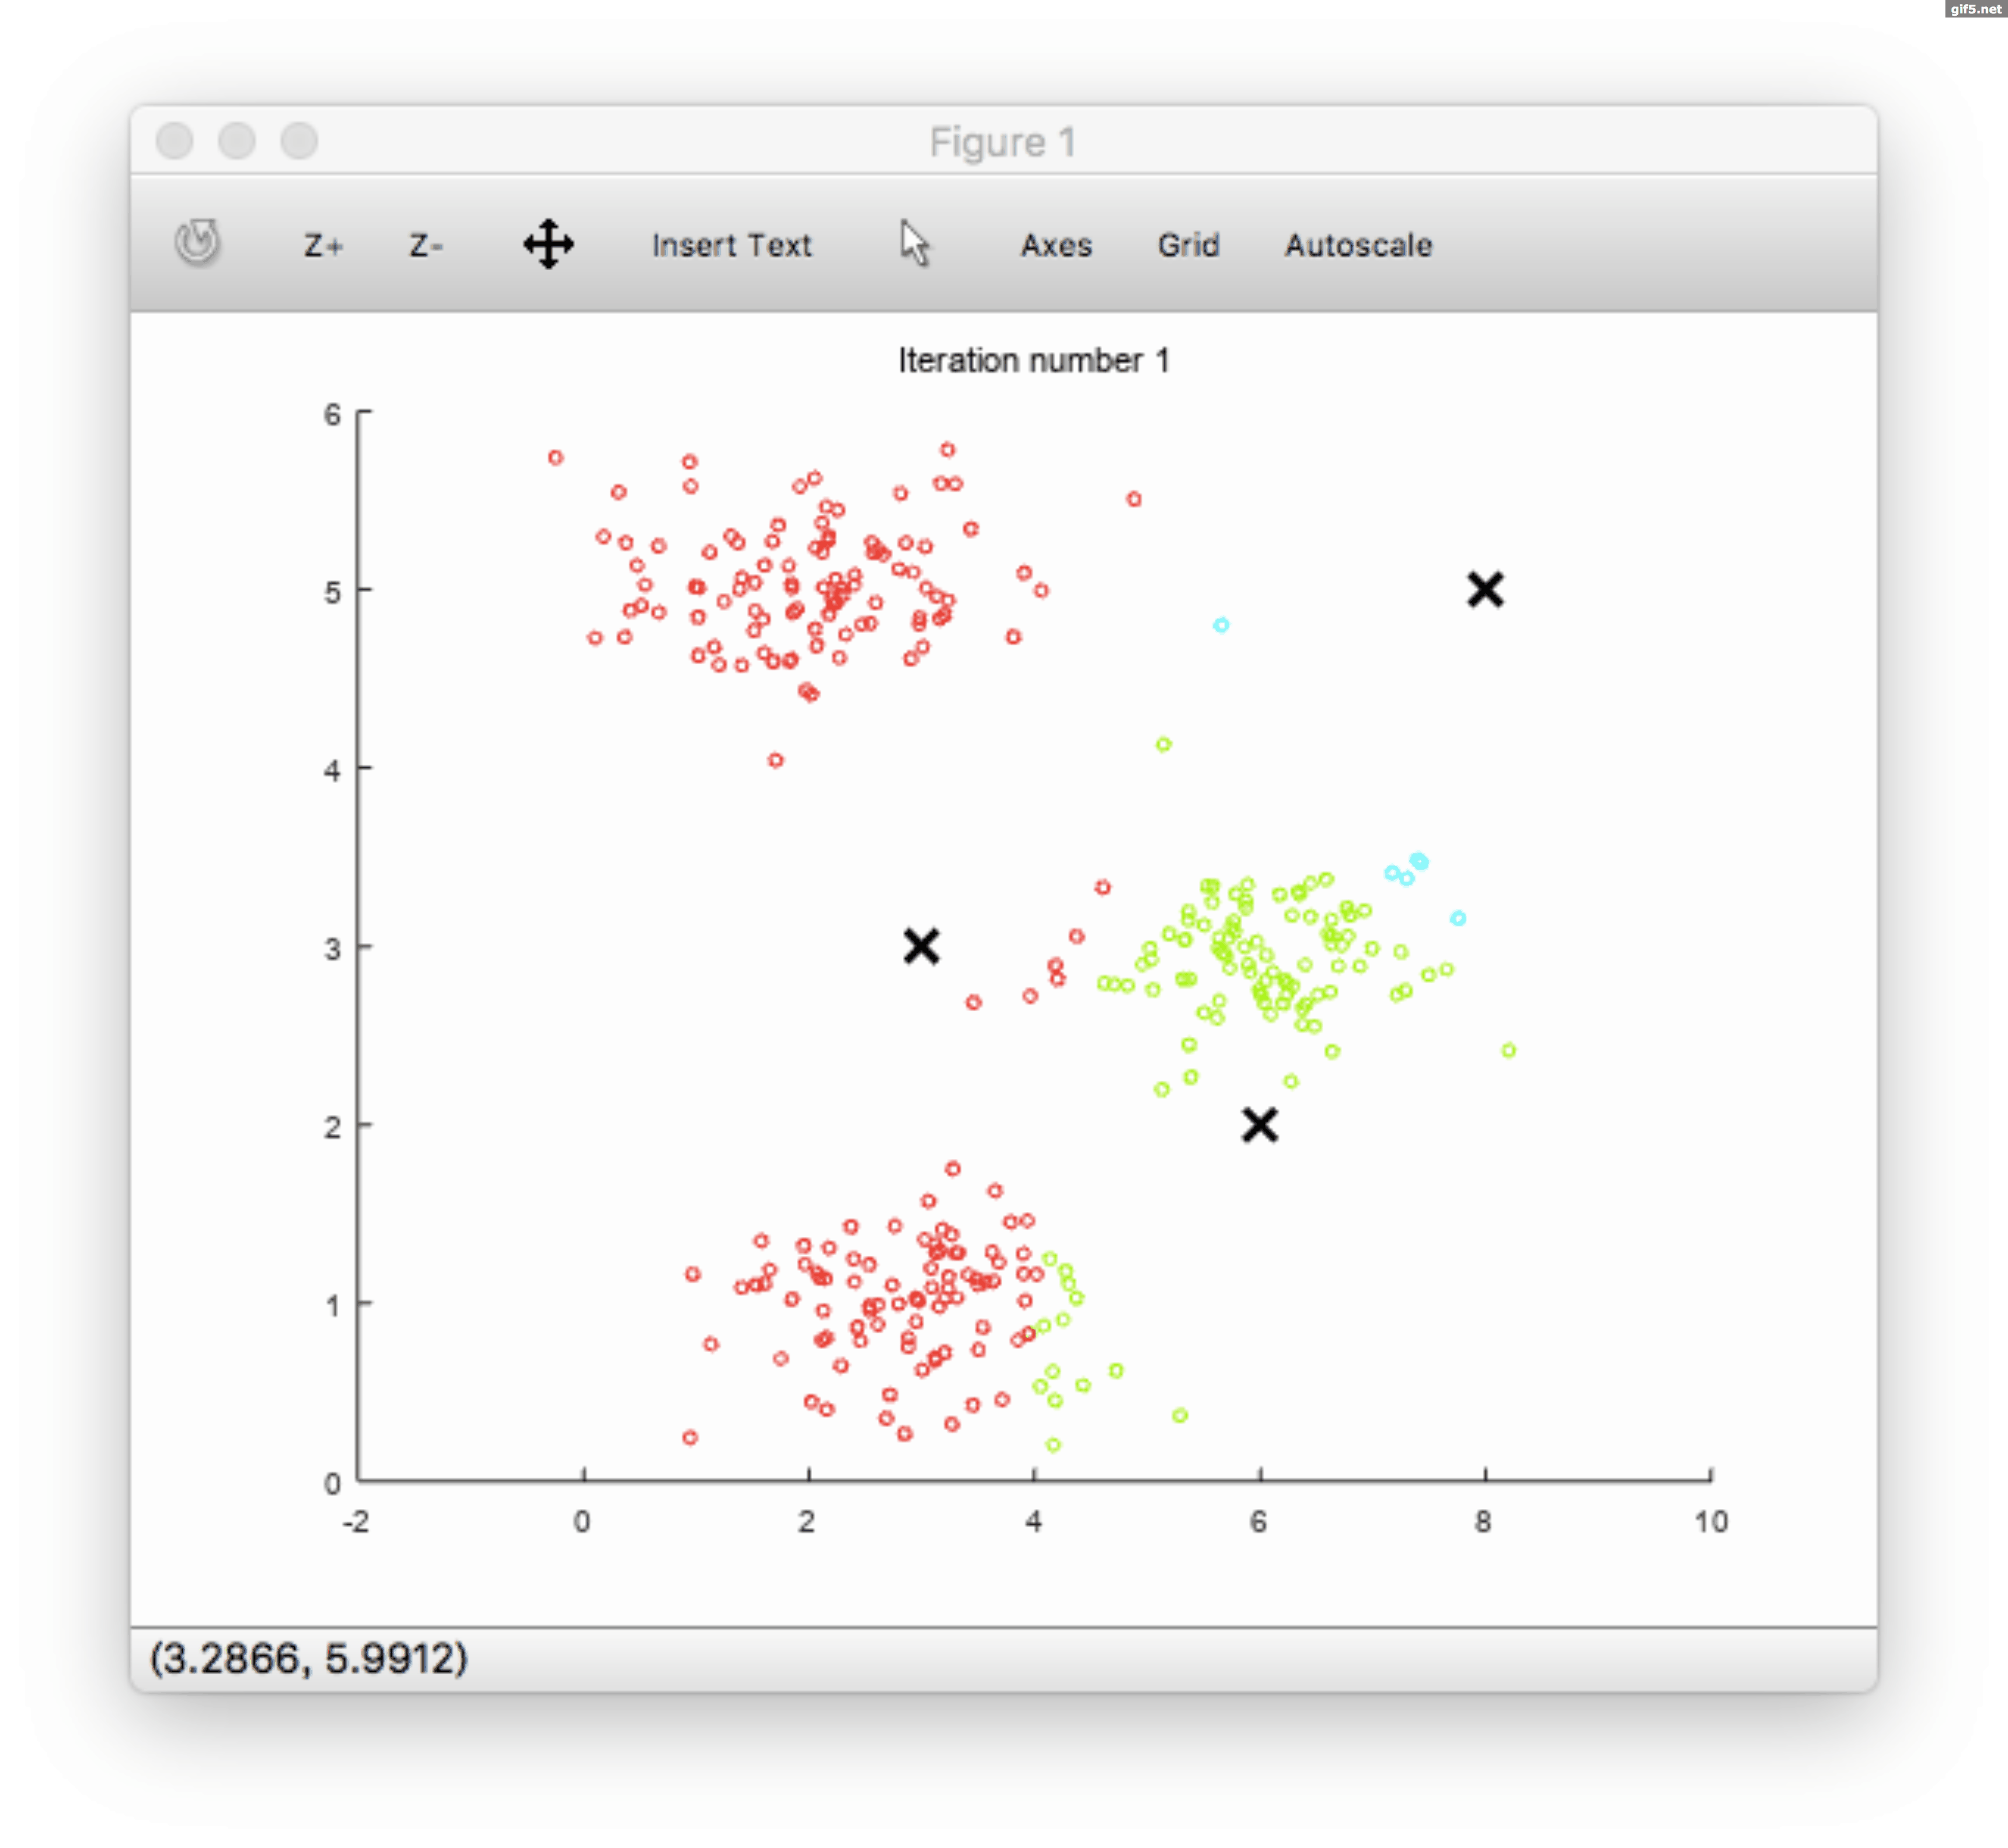
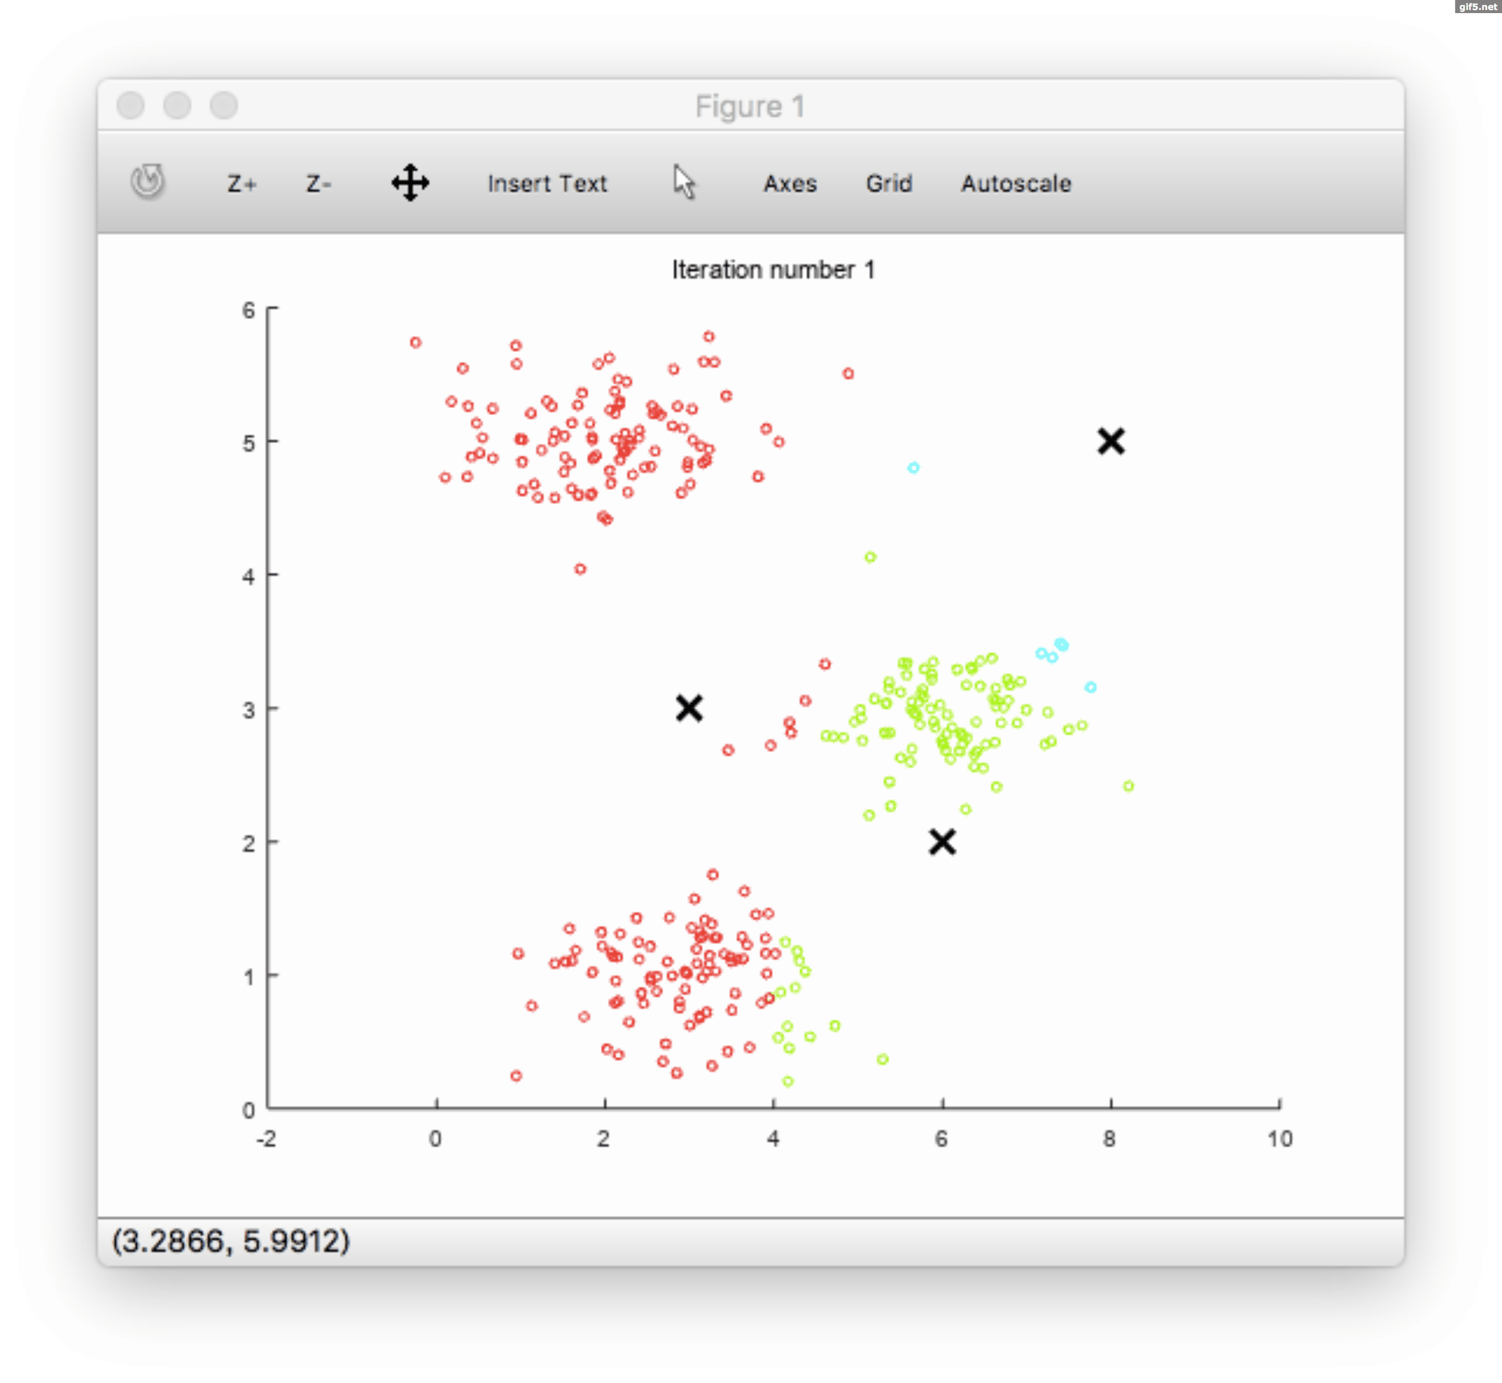

Slide 18
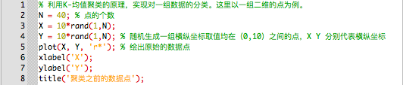
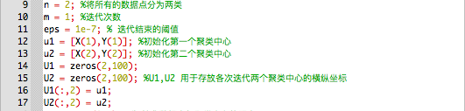
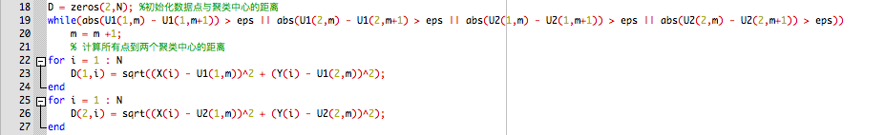
1. Generate two-dimensional random dot graphs
2. Initialization
3. Calculate the distance

Slide 19
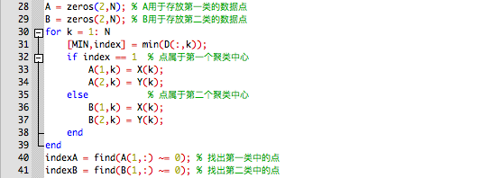
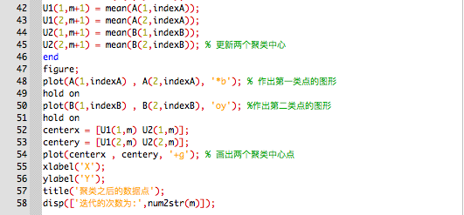
4.Cluster assignment
5. Move centriod

Slide 20
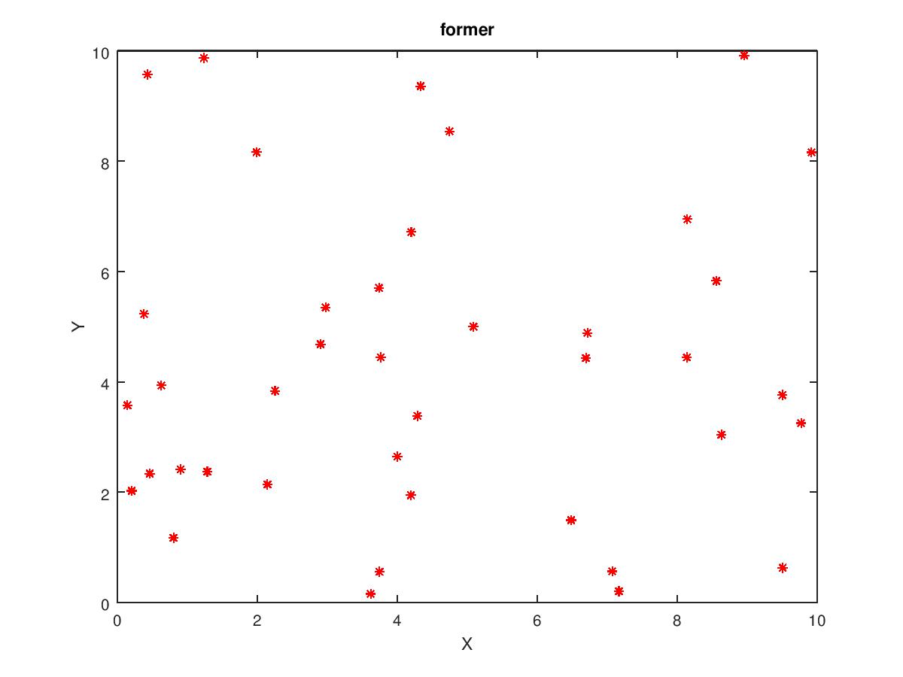
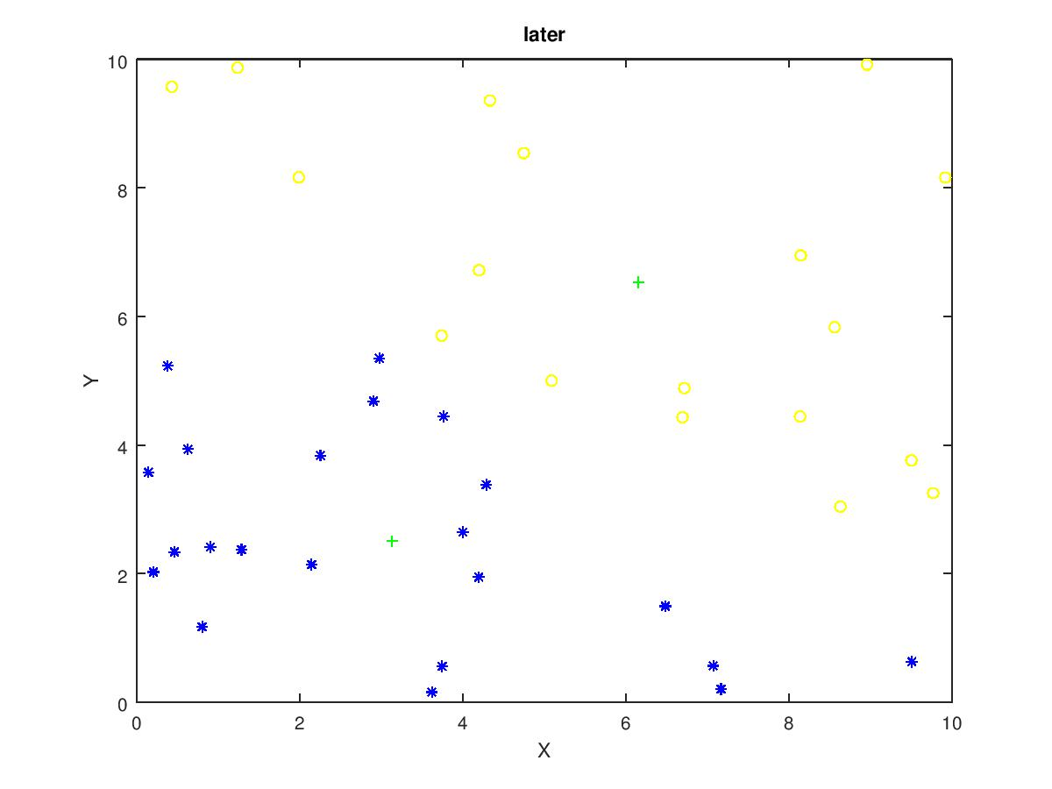
p56

Slide 21

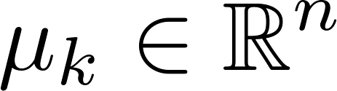
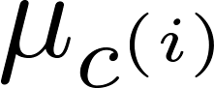
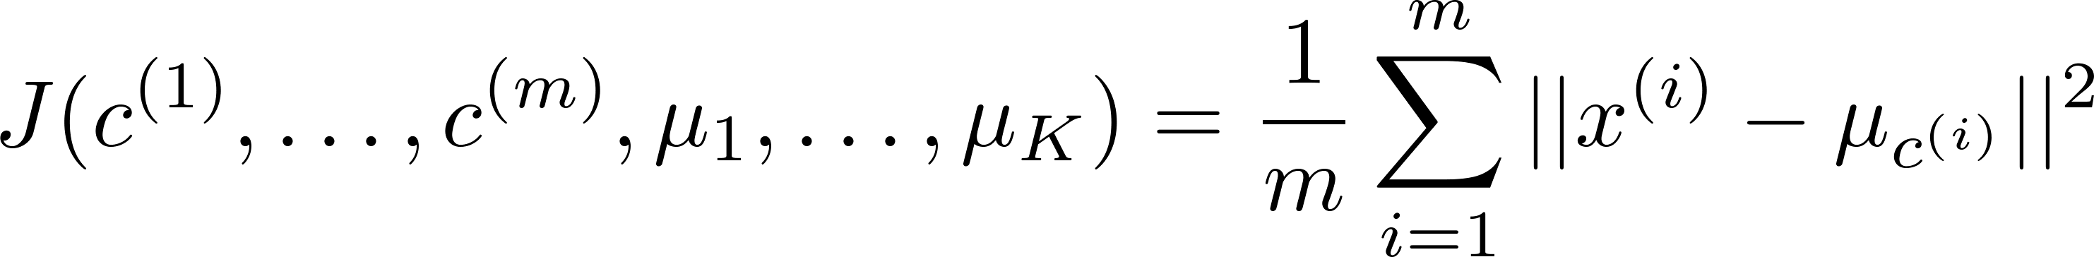
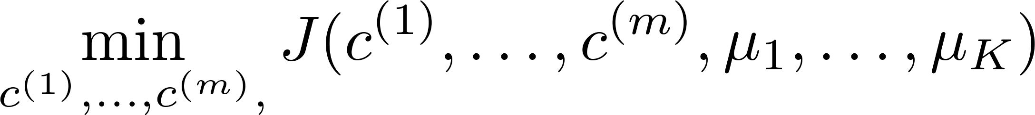
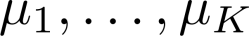
K-means optimization objective
= index of cluster (1,2,…, ) to which example is currently assigned
= cluster centroid ( )
= cluster centroid of cluster to which example has been assigned
Optimization objective:

Slide 22
Initialization

Slide 23

Choosing the value of K
Elbow method:
Cost function
Cost function
(no. of clusters)
(no. of clusters)

Slide 24
What is the right value of K?

Slide 25


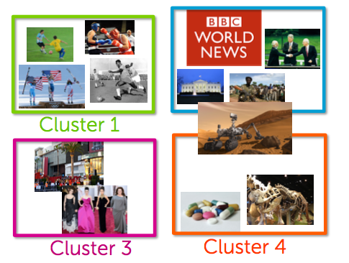
Applications of clustering
Market segmentation
Social network
analysis
Related documents

Slide 26
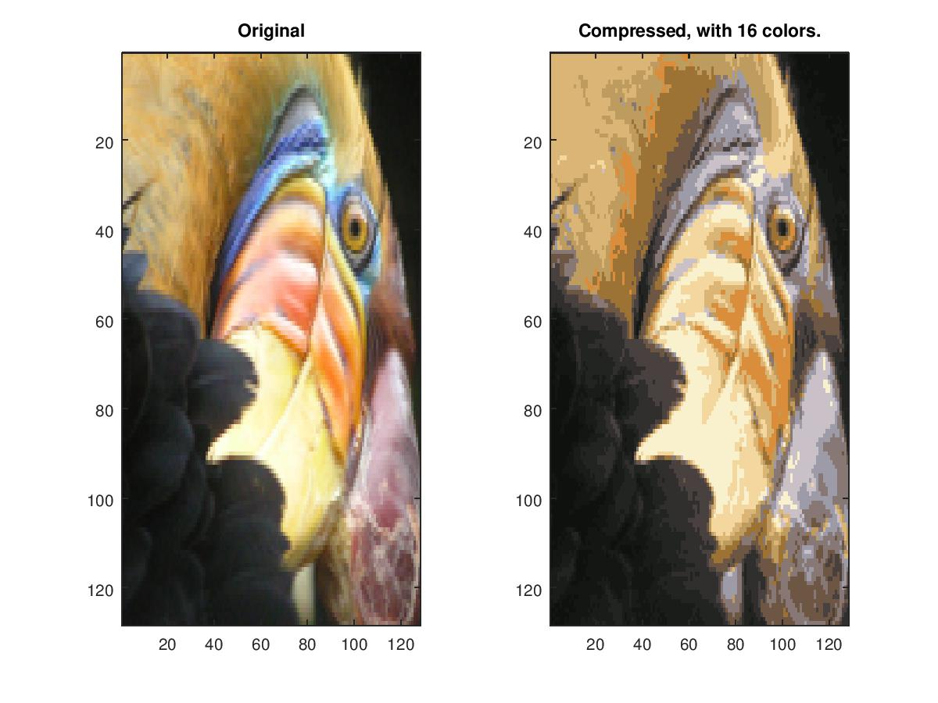
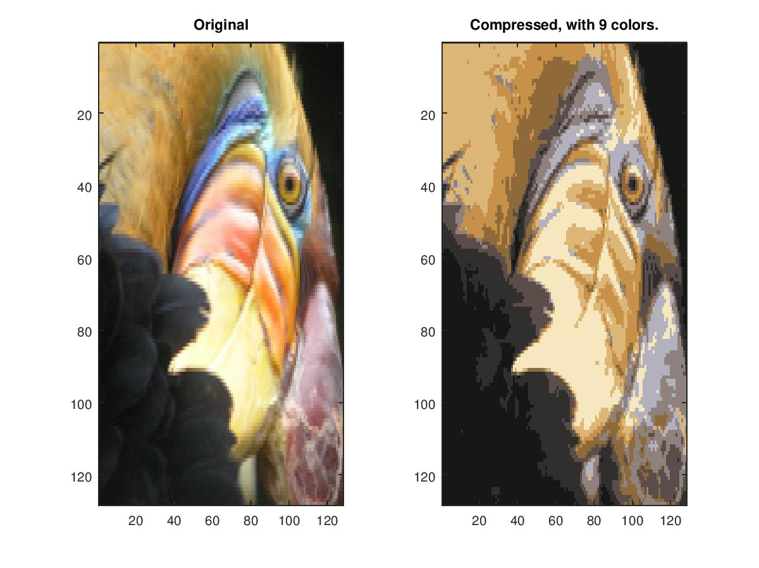
Applications of clustering
p57

Slide 27
PPT参考：
https://www.coursera.org/learn/machine-learning
https://www.coursera.org/learn/ml-clustering-and-retrieval

Slide 28
Thanks
Machine Perception and Interaction Group (MPIG)
www.mpig.com.cn
tl@mpig.com.cn
公众号:
mpig_robot

